Slide 1
Do this now
Write down
what you specifically want to get out of CP3402 in terms of industry preparation (for your job next year...)

Slide 2
CP3402 Content Management Systems
Introduction,
Review Web Design & Development

Slide 3
Learning Objectives – be able to…
Introduce the subject and its "different" structure and style
Prepare for a (potentially) different way of working and learning
Revise Web design and development skills and knowledge (expected in this subject)

Slide 4

We cover these Course Learning Outcomes
Demonstrate essential knowledge for a career in technology related professions and practice
Synthesise industry standard and underlying principles and concepts for decision making
Apply critical thinking to address IT related issues
Convey information clearly and fluently, in high quality written form appropriate for their audience
Demonstrate effective oral presentation skills for academic and professional audiences
Demonstrate the ability to work collaboratively
Apply technical skills, including numeracy, necessary for professional practice
Identify, and act upon, learning opportunities and self-improvements

Slide 5
Description
In this subject, students will learn about Web-based Content Management Systems (CMS), and use them to develop websites. Students will review CMS tools and technologies and evaluate them in terms of client requirements. Students will develop sites using front-end (client-side) and back-end (server-side) programming while considering issues of interface and user experience design, accessibility and Web standards.

Slide 6
Subject Learning Outcomes
Appraise the role of content management technologies to organise and present web content;
Create and deploy websites using content management systems, including creating and editing content, creating custom templates or themes, and performing site management;
Examine installation and maintenance considerations for modern websites;

Slide 7
Prerequisites
CP1406 OR CP2010 (Web Design)
AND
CP1404 (Programming)
AND
24 Credit Points of CP* subjects (8 subjects)
Warning: this is a 3rd year subject; we expect 3rd year independent learning

Slide 8
Not your usual subject format…
More self-directed than most IT subjects.
Significant amount of learning through online courses, mostly LinkedIn Learning and your own research.
Schedule time for this - put it in your calendar
Keep track in a learning journal
Lectures will introduce topics and include demonstrations, but won’t always prescribe
Up to you to compare and test different ways of achieving set goals
Practicals are supported practice/learning sessions (no walk-throughs) or group project work
You should not expect to be told what to do in this subject, but should be prepared to achieve set goals through finding and following a best course of action

Slide 9
Why? Why not just follow a textbook?
This subject is designed as an attempt to mimic modern development in industry, to help prepare you for the IT workforce
One of the most important attributes needed in developers is the ability to figure out what to do next, when it's unclear/unstructured
not just following steps, but determining and taking best action
We will use modern Agile development methods like:
stand-up meetings (every teamwork prac)
tools: virtual environments, version control, project management, communication
You get out what you put in - don't aim for the easiest, but the best

Slide 10
Jack said… (he's not the only story)
Hey Lindsay just wanted to thank you for the lecturing and advice you gave me over the years. I especially found the content management systems subject very important to future developmental skills, as well as introducing me to services like Digital Ocean and AWS (Especially since I'm working at AWS now!)
I don't think I would be where I am today without that class in particular. ... even for me at the time I felt a bit overwhelmed with the whole self learning aspect, but I also think it is important to show some initiative in your own learning. It's a tough subject but it does set the bar for the industry standard I've experienced so far. Thanks again :)

Slide 11
Assessment
A1 – 20% - Individual - same site in 2 CMSs
A2 – 40% - Group - custom WordPress theme site for a client
Presentation – 10% - Group - demo workflow
Practicals – 30% - Learning activities + Individual exercises + Group meetings/work

Slide 12
Assessment
Group work = no “freeloading”
We expect to see a history of interaction and activity
(freeloaders will have minimal evidence of activity)
Peer assessment will be used to evaluate (and scale down)
Use modern systems to manage teamwork
GitHub, Trello, Slack, Discord, Google docs/hangouts/calendar, etc.

Slide 13
Technology
(It will really help if you use your own laptop)
Research and choose the ‘best’ technologies (A2 and Presentation)
Local development environment
Vagrant (Linux-based), Docker…
Staging environment & production environment (hosting)
Amazon Web Services (AWS), DigitalOcean…
Modern development tools and workflow
WordPress
PHP, HTML, CSS, Sass, some JavaScript
and/or whatever else you decide is best

Slide 14

Here it is…
https://github.com/CP3402/subject/wiki/Calendar

Slide 15
Review of CP1406 – Web 1
Exam time!
Get ready to write down your answers…

Slide 16
Revision Test
Which one of the following is a CSS style rule that could be described as: “The content of the element will be red, with 20 pixels of space the same colour as the element background, then a yellow border.”
color: red; padding:20px; border:solid yellow;
content: red; padding:20px; border-color: yellow;
font-color: red; padding:20px; border-color: yellow;
color: red; margin:20px; border solid: yellow;

Slide 17
Revision Test
Write a CSS style rule for a class called “warning” with white text, a red background colour and 2 em of padding on the top and bottom sides.
Explain the difference between the <div> and <span> elements, both technically and in terms of how they should be used.
List two empty (void) HTML elements and two non-empty elements

Slide 18
Revision Test
Describe at least 3 differences between JPEG and GIF image formats and how you would choose one format over the other
Describe the task analysis process for website usability testing and explain two (2) reasons why it is a good method.
Write the (minimal) HTML for a form that sends a user's name (text field and submit button) to hi.php.

Slide 19
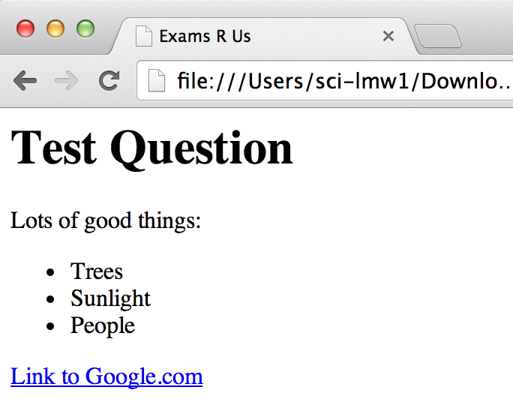
Revision Test
Write the HTML code to produce the following Web page:

Slide 20
Revision Test
What do each of the following JavaScript functions do:
alert("Good")
confirm("Do you want X?")
prompt("What is your name?")
Explain what the following CSS selector selects: div#abc > p {…}
What is the number 1 rule of Web design and development? The bottom line… The most important thing...?

Slide 21
...answers in a separate document...

Slide 22
What do you want?
Notes:
Ask: what do you want to get out of the subject; and… how do you want to do things? (element of self-managed learning, can be flexible)

Slide 23
Jim Rohn
"Don’t wish it was easier, wish you were better. Don’t wish for less problems, wish for more skills. Don’t wish for less challenges, wish for more wisdom."

Slide 24
Summary
Be prepared to work independently and in a self-motivated way (CLO: Identify, and act upon, learning opportunities and self-improvements)
Schedule time for independent learning!
Don't just aim for the 'easiest', but the 'best'
If you didn't do well with the revision... quickly catch up on:
HTML
CSS
JavaScript
Principles - design, images, usability, goal-driven Web design

